Slide 1
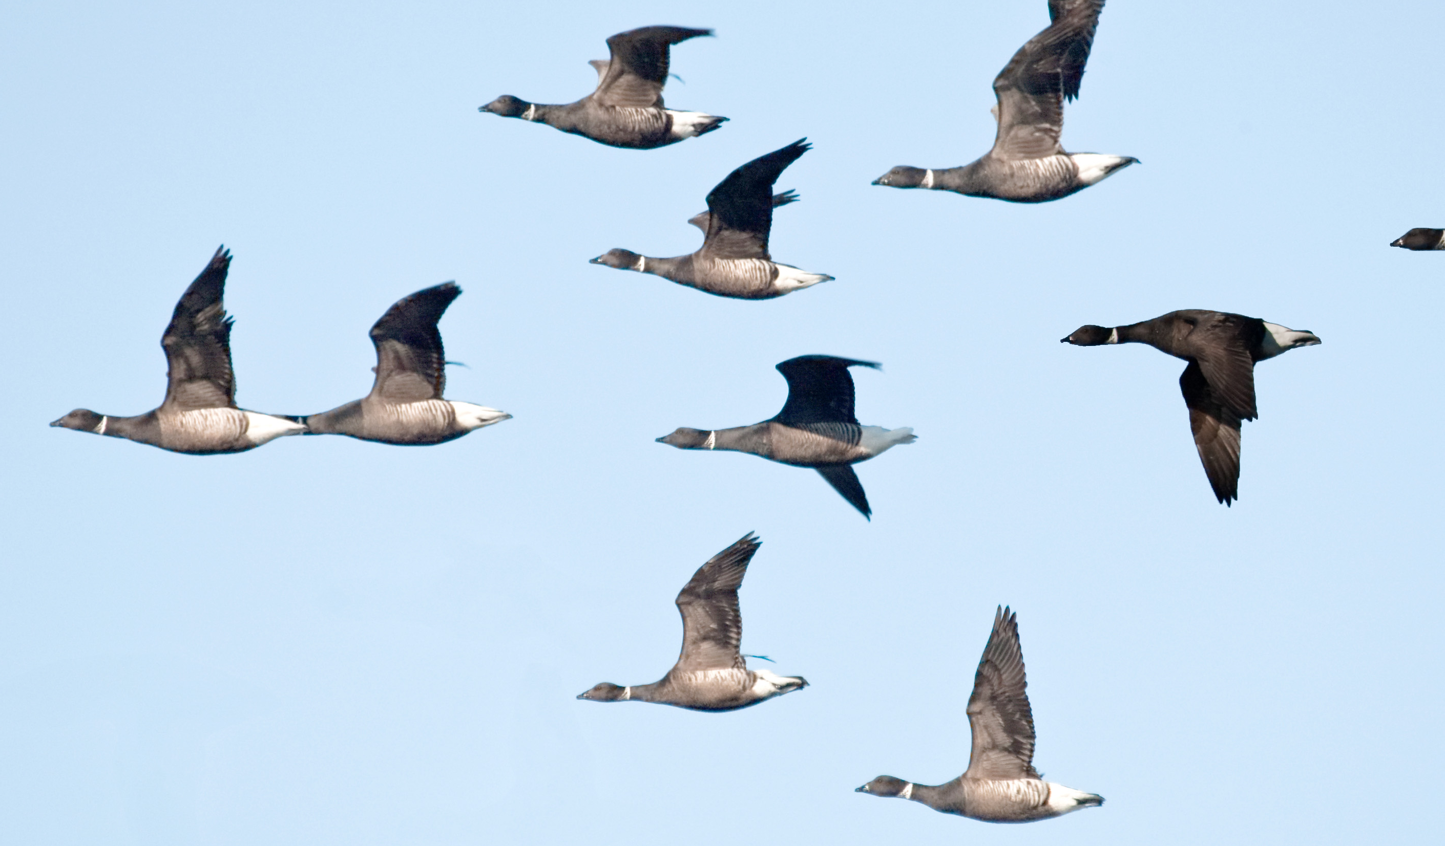

Machine Learning Competitions
Slides generously provided by: Ben Hamner, Chief Scientist
Kaggle
Photo by mikebaird, www.flickr.com/photos/mikebaird

Slide 2
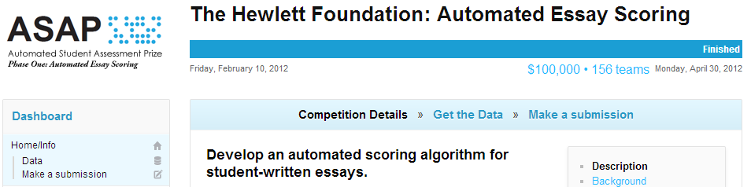

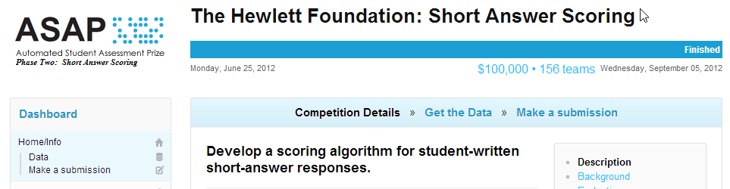
Automatically grading student written essays and short answers
www.kaggle.com/c/asap-aes
www.kaggle.com/c/asap-sas

Slide 3
Data for grading short answers
10 short answer prompts
3,000 responses per prompt
~30,000 total responses
12,000 hand-written and then transcribed
18,000 digitally entered
8th and 10th grade students
3 different US states
Each response graded by at least two teachers

Slide 4
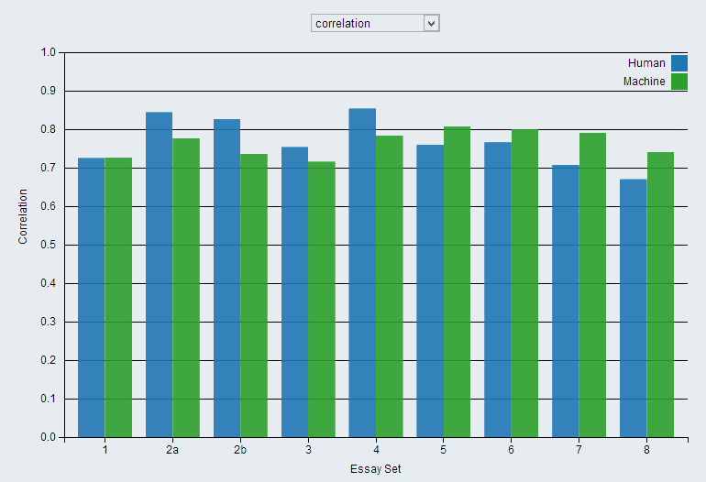
The best automated essay grading methodologies performed on par with the human graders

Slide 5
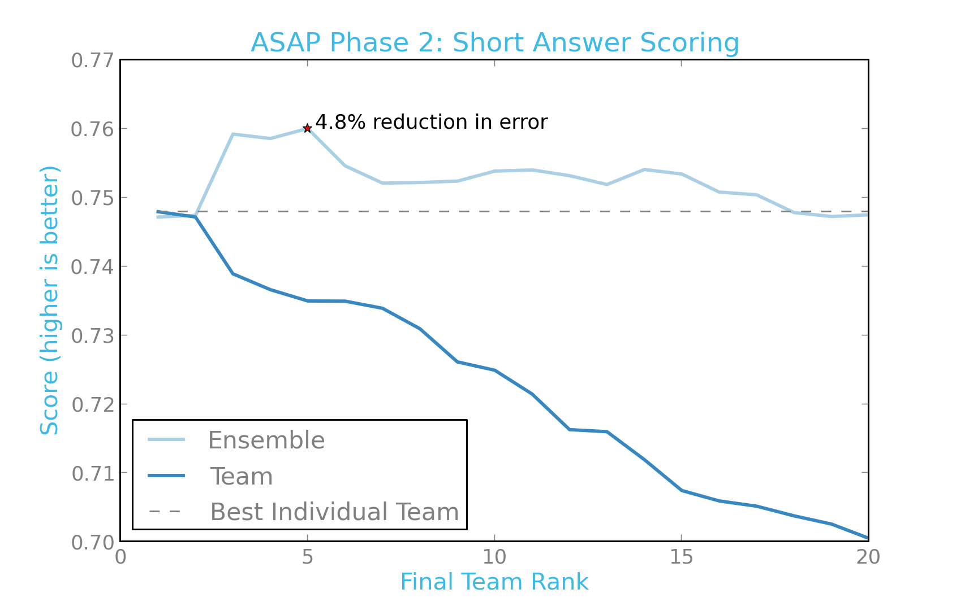
Ensembling the solutions from the top teams produced a significant additional improvement

Slide 6
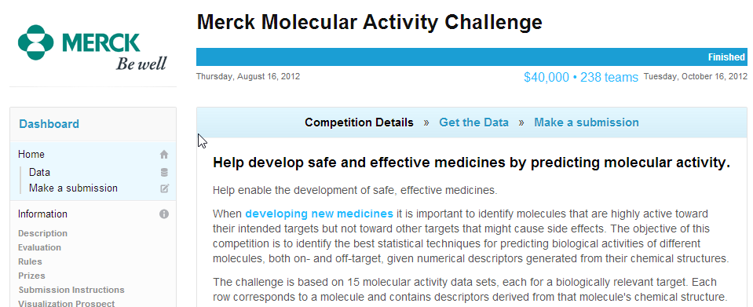
Predicting molecular activity from molecular structure and properties
15 supervised regression data sets
Each with a single feature matrix of molecules and their numerical descriptors
1569-37241 molecules / set
4308-9493 descriptors / molecule
Evaluated with mean correlation coefficient
www.kaggle.com/c/MerckActivity

Slide 7
The winning methodology used a generic approach that exploited commonalities in the 15 problems
Preprocessing Methods
Minimal preprocessing
Log-transformed features where appropriate
Supervised Machine Learning Methods
Single-task deep neural network with dropout
Rectified linear hidden units
Multi-task deep neural network with dropout
Rectified linear hidden units
15 output units corresponding to the 15 tasks
Gaussian process regression
Ensembled with an equally-weighted blend of the three models
“No random forests were harmed (or used) in the creation of our solution.”
blog.kaggle.com/2012/11/01/deep-learning-how-i-did-it-merck-1st-place-interview/

Slide 8
The next two places used complex and model-specific feature extraction & selection steps
2nd Place Methods
Complex and model-specific feature extraction and selection steps -> Random Forests, Support Vector Machines, and Gradient-Boosted Machines -> blending
“The most surprising thing was that almost all attempts to use subject matter knowledge or insights drawn from data visualization led to drastically worse results. We actually arranged a 2 hour whiteboard lecture from a very talented biochemist and came up with some ideas based on what we learned, but none of them worked out.”
3rd Place Methods
Singular Value Decomposition / Lasso Regression
Support Vector Machines, Random Forests, Neural Networks, and Gradient Boosted Machines, and Multiple Linear Regression
Hierarchical ensemble to combine models
blog.kaggle.com/2012/11/04/team-datarobot-merck-2nd-place-interview/
blog.kaggle.com/2012/11/05/team-takes-3rd-in-the-merck-challenge/

Slide 9
Ensembling the top models in the Merck Molecular Activity challenge

Slide 10
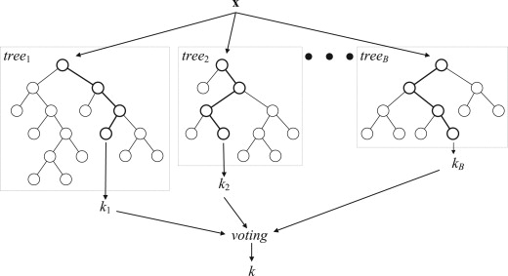
Random Forests / GBM’s work very well for many common classification and regression tasks
(Verikas et al. 2011)

Slide 11




Competitions don’t typically yield simple and theoretically elegant solutions
*exception – Factorization Machines in KDD Cup 2012

Slide 12
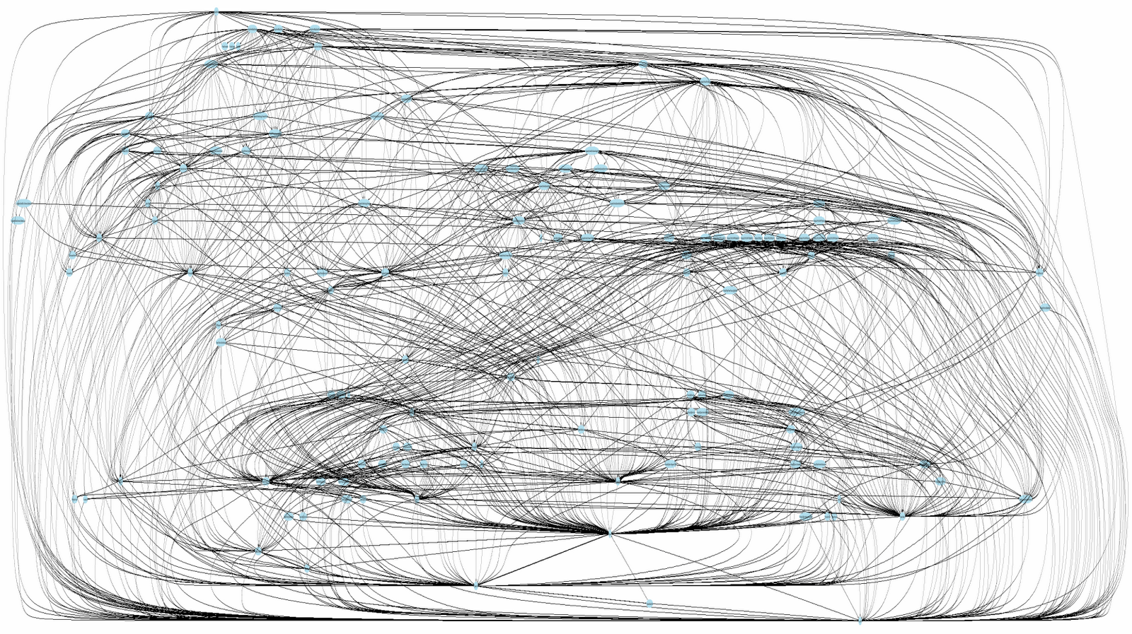
Competitions don’t typically yield production code
http://ora-00001.blogspot.ru/2011/07/mythbusters-stored-procedures-edition.html

Slide 13
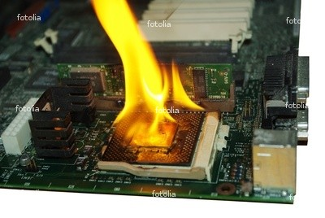
Competitions don’t always yield computationally efficient solutions
Rewards performance without computational and complexity constraints
http://iinustechtips.com/main/topic/193045-need-help-underclocking-d/

